Slide 1
Image colourization using
CNN
Done by
U.INBAKUMAR
Reg.No. :912321104010
III-year , CSE
SACS MAVMM ENGINEERING COLLEGE

Slide 2
Project outline:
Problem statement
Proposed system/solution
System development approach
Algorithm and deployment
Result
conclution

Slide 3
Problem Statement:
image colorization using Convolutional Neural Networks (CNNs) is to train a deep learning model that can take grayscale images as input and generate corresponding colorized versions. This involves developing an architecture that can effectively learn the mapping between grayscale and color images, capturing complex relationships and dependencies within the data. The goal is to produce colorizations that are visually pleasing and semantically meaningful, preserving important details and textures from the original images. The CNN model needs to be trained on a dataset of grayscale-color image pairs to learn how to accurately predict colors for grayscale inputs.

Slide 4
Proposed System /solution
Data Collection and Preprocessing: Gather a large dataset of grayscale images paired with their corresponding color images. Preprocess the data by resizing images to a standard size and normalizing pixel values. Model Architecture Design: Design a CNN architecture suitable for image colorization. One common approach is to use an encoder-decoder architecture. The encoder extracts features from the grayscale image,
the decoder generates the corresponding colorized image. Consider using architectures like U-Net, which incorporate skip connections for better feature propagation.
Loss Function Selection: Define a loss function to measure the difference between the predicted colorized image and the ground truth color image. Popular choices include Mean Squared Error (MSE)

Slide 5
Proposed System/solution (contd…)
Evaluation: Evaluate the trained model on a separate validation set to assess its performance.
Use metrics such as PSNR (Peak Signal-to-Noise Ratio) and SSIM (Structural Similarity Index) to quantify the quality of colorization
User Interaction: Provide options for users to customize the colorization process, such as adjusting color saturation, brightness, or applying artistic filters.
This enhances user engagement and satisfaction with the system.
Performance Optimization: Optimize the model and deployment infrastructure for performance and efficiency.
Techniques such as model compression, quantization, and hardware acceleration can help achieve real-time colorization on resource-constrained devices.

Slide 6
System development approach
Problem Understanding and Definition:Clearly define the problem statement and objectives of the image colorization system.Understand the requirements and constraints, such as real-time processing, scalability, and user intraction.
Training Strategy:Determine the training strategy, including batch size, learning rate schedule, optimizer (e.g., Adam), and regularization techniques (e.g., dropout, weight decay).
Train the model on the training dataset using GPUs or TPUs to accelerate computation, monitoring training progress with metrics and visualization tools.
Validation and Hyperparameter Tuning:Validate the model on the validation dataset to evaluate its generalization performance
Perform hyperparameter tuning, adjusting model architecture, optimizer parameters, and regularization settings based on validation results to improve perfometrics
Testing and Evaluation:Evaluate the trained model on the test dataset using selected evaluation metrics to assess its performance in real-world scenarios.Analyze the colorization results qualitatively by visual inspection andquantitatively

Slide 7
Algorithm steps
These projects are performed by Convolutional Neural Networks (CNNs)
Data Collection and Preprocessing
Model Architecture Design
Encoder Network
Bottlneck layer
Decoder Network
Loss function
training

Slide 8
Deployment steps
Model Serialization:Serialize the trained CNN model into a file format suitable for deployment, such as HDF5 or ONNX. Integration with Deployment Environment:Integrate the colorization model into the deployment environment,
whether it’s a web service, mobile app, or desktop application.Ensure compatibility with the programming languages and frameworks used in the deployment environment.
Input Handling:Implement functionality to receive grayscale images as input from users or other system
Model Inference:Use the deployed CNN model to perform inference on the input grayscale images, generating colorized outputs.
Output Presentation:Present the colorized images to users through the deployment interface, such as a web page, mobile app UI, or desktop application window.
Performance Monitoring and Maintenance:Monitor the performance of the deployed colorization system in production environments.

Slide 9
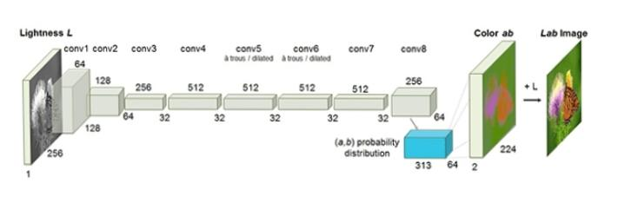
Colorize black and white images with deep learning

Slide 10
Who are the end user?
Photographers and graphic designers: Professionals who may use image colorization techniques to enhance or restore old photographs, create artistic effects, or improve visual appeal in various design
Historians and archivists: Individuals or organizations working with historical photographs or archival material may use colorization to bring old images to life and provide a new perspective on historical
Entertainment industry professionals: Film and television producers, animators,
game developers may utilize image colorization techniques to add color to grayscale footage or artwork, creating immersive visual experiences for audiences.

Slide 11
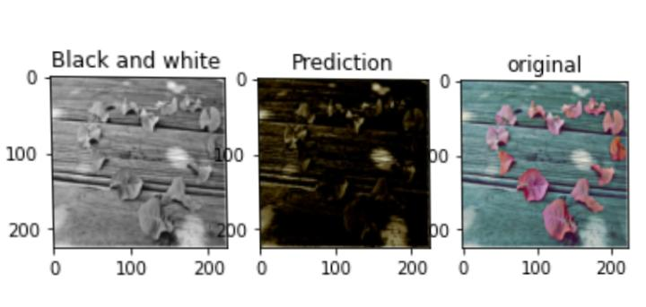
Result
Fig. : image colourization

Slide 12
Reference
https://matplotlib.org/
https://pandas.pydata.org/
https://keras.io/
http://transflow.in/
https://pypi.org/project/opencv-python/
https://numpy.org/
Dataset link
https://www.kaggle.com/datasets/shravankumar9892/image-colorization/download?datasetVersionNumber=4

Slide 13
Conclusion
Image colorization using Convolutional Neural Networks (CNNs) offers a powerful and effective method for automatically adding color to grayscale images. By leveraging deep learning techniques, CNN-based colorization models can learn complex mappings between grayscale inputs and corresponding color outputs, producing visually appealing and realistic results. Through the algorithmic steps of data preparation, model architecture design, training, and deployment, CNNs can accurately generate colorized images

Slide 14
Thank you..!

